Slide 1
Nitrogen balance
ا.د.جمال احمد عبد الباري
استاذ الكيمياء الحياتيه السريريه

Slide 2
Nitrogen balance
Represent the differences between total nitrogen intake and the nitrogen loss.
1- Positive nitrogen balance:
The ingestion of more nitrogen than that excreted, which will be occur in a growing infant or pregnant woman.
2- Nitrogen equilibrium:
Typical for an adult human subject, nitrogen intake match nitrogen out put in feces and urine.
3- Negative nitrogen balance:
In which nitrogen output exceeds the intake, as in post surgical patients or in patients with advances cancer, and when ingested in adequate nitrogen (kwashiorkor).

Slide 3
1-2 % of total protein /day are turnover from degradation of muscle protein.
75-80% of liberated amino acid is then reutilized for new protein synthesis.
The remainder nitrogen is catabolized to urea and the carbon skeletons to amphibolic intermediates.
This represent daily loss amount to 30-40 g of protein or 5-7 g of nitrogen, and requirement 30-60 g protein /day.

Slide 4
Plasma Protein
Proteins are present in all body fluids but there is the proteins of the blood plasma that are examined most frequently diagnosis.
Metabolism of plasma proteins
The plasma levels of proteins depend on the balance between their synthesis and their catabolism or loss from the body. Many plasma proteins are synthesized in the liver, plasma cells and lymphocytes synthesized immunoglobulin, while proteins of complement system are synthesized by macrophages and hepatic cells.
Small proteins are passively loss through
The renal glomerulus's . and
Small intestinal wall.
Then reabsorbed either directly by renal tubular cells or after digestion in the intestinal tract.
The catabolism of proteins by capillary endothelial cells.

Slide 5
Vartions in the plasma protein concentration can be due to:
1.The rate of protein synthesis.
2. Rate of removal.
3. Volume of distribution

Slide 6
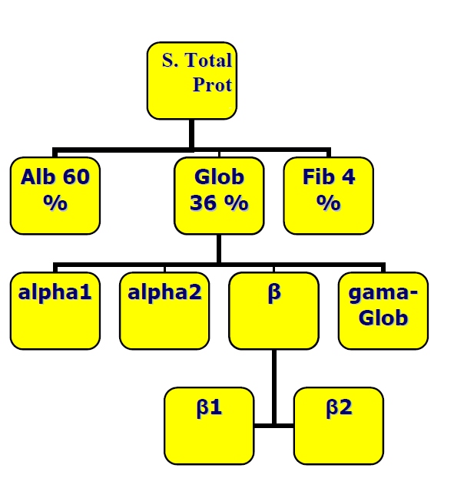

Slide 7
Functions of plasma proteins
1- Transport: Thyroxin-binding globulin, Apo lipoproteins, transferrin.
Albumin are specific binding protein for its, vitamin, bilirubin, lipids and trace metals and drug.
2- Humoral immunity: As immunoglobulin.
3- Maintenance of oncotic pressure:
All protein, particularly albumin.
4- Enzymes: Rennin and clotting factor.
5- Protease inhibitor: α1 antitrypsin.
6- Buffering: All proteins.

Slide 8
Methods of assessing plasma protein
Protein can be measured as total proteins, or as
individuals as albumin.
Changes in the relative percentage of group of protein may
be assessed after electrophoresis of serum or plasma.

Slide 9
Total proteins
The concentrations of proteins in the plasma is affected by
1- Posture: Increase by 10-20% within 30min. of becoming up right after a period of recumbence.
If a tourniquet is applied before vein puncture. A significant rise in the concentration of protein within few minutes. This is caused by an increased diffusion of fluid from the vascular → into the interstitial.
2- When there is a change in the more abundant plasma protein as albumin and immunoglobulin.
3- In dehydration: Due to a decrease in the volume of distribution or on the other hand a rapid decrease in the concentration Due to an increase in plasma volume.
Plasma protein concentration can provide valuable information to the assessment of patient's state of hydration.
4- Rapid decrease in the concentration of total plasma protein if the capillary permeability increase as in septicemia and generalized inflammatory conditions

Slide 10
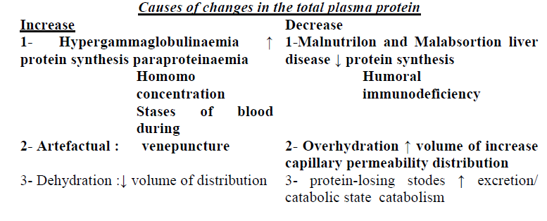

Slide 11
Electrophoresis
This is used for semi-quantitative assessment of serum proteins and is essential for the detection of Para proteins. If the plasma used rather than serum, six band produce, and fibrinogen appear in the β-γ region.
Electrophoresis on cellulose acetate or agarose gel separates the proteins into five bands: Albumin, α1 and α2 globulins, β-globulins and γ- globulins
Class of protein
1. Albumin and pre albumin.
2. α1 globulins: α1 - anti trypsin , α1 -acid glycol proteins.
3. α2 globulins: Hepatoglobulins , α2 -macro globulin and ceruloplasmin.
4. β-globulins: Transferring LDL, complement C3 proteins.
5. γ- globulin: IgG, IgA, IgM , IgD, IgE.

Slide 12
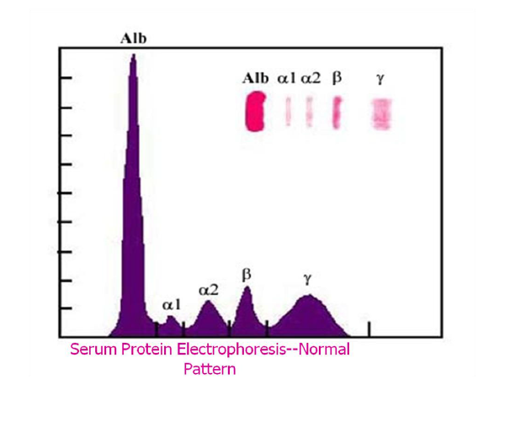

Slide 13
Normal
Acute phase reaction
Chronic inflammation
Cirrhosis: low alb. Level and a diffuse increase in γ- globulins and β- γ fusion due to increase in IgA, this occur in advance cases and of little diagnostic value
Nephrotic syndrome: ↓ in alb., α1 and γ- globulins, increase in α2 and β2 (due to α2 -macro globulin and Apo lipoprotein B) it can only seen in very sever case and other protein losing states.
α1- anti trypsin deficiency: the major component, it is occur in homozygote for the z gene but α1 in normal in heterozygote.
Paraproteinaemia with immune suppression: The use of serum protein electrophoresis to detect par proteins.
Hypogamna globulinaemia: ↓ in γ- globulins seen in defect of humeral immunity involving IgG the major component of total γ- globulins
Normal

Slide 14
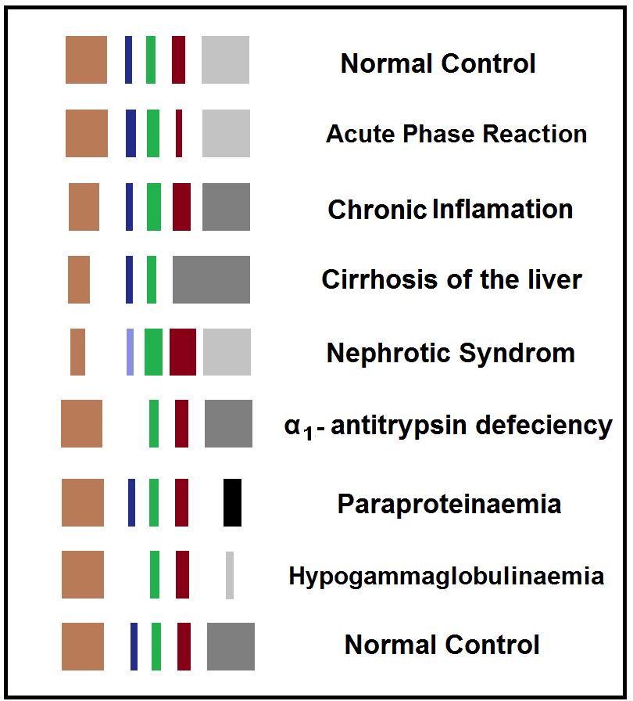

Slide 15
a= Normal
b= Nephrotic syndrome: ↓ in alb., α1 and γ- globulins, increase in α2 and β2 (due to α2 -macro globulin and Apo lipoprotein B) it can only seen in very sever case and other protein losing states.
c= Hypogamna globulinaemia: ↓ in γ- globulins seen in defect of humeral immunity involving IgG the major component of total γ- globulins
d= Cirrhosis: low alb. Level and a diffuse increase in γ- globulins and β- γ fusion due to increase in IgA, this occur in advance cases and of little diagnostic value
e= α1- anti trypsin deficiency: The major component, it is occur in homozygote for the z gene but α1 in normal in heterozygote.
f= Hyper gamma globulinaemia: This diffuses hyper gamma globulinaemia.
g= Paraproteinaemia with immune suppression: The use of serum protein electrophoresis to detect par proteins.

Slide 16
Albumins
Albumins are the most abundant plasma protein makes the greatest contribution to the oncotic pressure of plasma.
Albumin has a m.wt of 65.000 Daltons, it is synthesized in liver. in plasma its t l/2 = 20 days.
Albumin is used in maintaining plasma volume.
Two rare of congenital abnormalities of albumin synthesis.
1- Bis albuminaemia.
2- An albuminaemia, there is a defection in protein synthesis

Slide 17
High plasma albumin levels:
Found only with dehydration, or artfactually in a sample taken with prolonged venous stasis.
Low Albumin levels are of clinical importance
Cause of hypo albumina
1. Dilution by an excess of protein free fluid.
2. Redistribution in to interstitial fluid due to increased capillary permeability.
The true albumin deficiency due to a decreased rate of synthesis, or increase rate of catabolism, or loss from the body.
3. Decrease rate of synthesis 4% of body albumin is replaced each day by hepatic synthesis.

Slide 18
Impairment the synthesis will cause hypoalbuminaemia, and this due to
a- Malnutrition or malabsorption.
b- Chronic liver dysfunction.
4. Increase the catabolism of albumin as in fever.
5. Increase loss of alb. From the body.
Because of its relativity low m.wt of albumin, signification amounts are lost in a conditions in which there are an increased in permeability of membrane separating plasma from the outside of the body.
The loss is through
a. The glomerulus's as in Nephrotic syndrome.
b. The skin because of extensive burns, or in skin disease as in psoriasis.
c. From the intestinal wall as in protein losing entro-pathy.

Slide 19
Results of Hypoalbuminaemia
1- Fluid distribution: Albumin is the most important protein contributing to plasma colloid osmotic pressure.
In hypoalbuminaemia, there will be a decrease in plasma oncotic pressure, disturbs the equilibrium between the plasma and interstitial fluid back into the blood at the end of capillaries.
The accumulation of interstitial fluid is seen clinically as Edema.
2- Binding function: 1/2 of calcium is bound to Albumin and hypoalbuminaemia produce hypocalcaemia. Albumin also binds to bilirubin, free fatty acid and number of drugs salicylate, penicillin and sulphon amides.
A marked reduction in plasma Albumin leads to reduction the binding capacity, may increase free levels of these substance and cause toxic effects if drugs are given in their normal dosage.

Slide 20
Protein uria
The loss of most plasma protein through the kidney is restricted by
1. The size of the pores.
2. The (-ve) charge on the glomerular basement membrane that repels negatively charged protein molecule.
Alteration of either of these fractions by glomerular disease may allow albumin and larger protein to filtrate.
Low m.wt proteins are filtered even under normal condition. Most are absorbed and metabolized by renal tubular cells, normal subject excreted =0.08g/day of protein in the urine which is un detectable by usual tests.
Protein uria, of more than 0.15g/day always indicates disease.
Protein uria be due to
1. Renal disease.
2. Rarely due to increase in concentration of plasma low m.wt protein.
Blood and pus in the urine give false (+ve) tests of proteins).

Slide 21
Types of protein urea
1- Renal protein uria
a. Glomemral protein uria: Due to increased glomerular permeability as in (nephrotic syndrome). Albumins mainly appear in the urine.
Orthostatic (postural): Most protein uria is more sever in upright than in prone position, which disappears at night.
b. Tubular protein uria: Due to renal tubular damage from any causes, especially pyelonephritis.
2- Protein uria with normal renal function
Protein uria can be due to production of Bence Jones Protein, sever hemolysis with hemoglobin uria, in muscle damage in Myoglobin uria, in the later cases the urine will be red or brown in color.

Slide 22
Nephrotic syndrome:
Increase in glomerular permeability causes a protein loss, of more than 6g / day with consequent hypoalbuminaemia and edema and with hyperlipoproteinaemian.
The renal disease may primary or secondary.
1) Primary as in glomerulonephritis due to deposition of circulating immune complex in glomerulus's.
2) Secondary due to:
1- Diabetes mellitus.
2- Renal vein thrombosis.
3- Malaria (due to immune complex).

Slide 23
Thank You

